Slide 1


SMART INDIA HACKATHON 2024
TITLE PAGE
Problem Statement ID - SIH1630
Problem Statement Title - Mentor Connect
Theme - Smart Education
PS Category - Software
Team ID - DJ105
Team Name - ConnectMinds

Slide 2
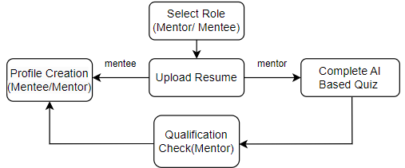
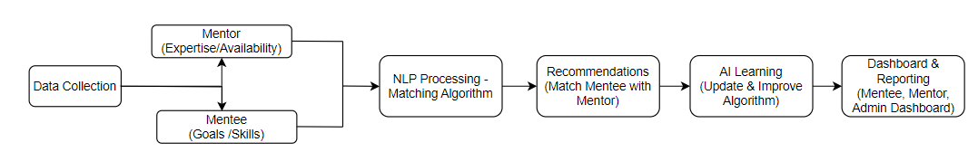
IDEA TITLE
ConnectMinds
Objective: Connect candidates (mentees) with industry experts (mentors) to foster career growth and skill development.
Need: India’s growing workforce and diverse career paths require structured mentoring to guide candidates effectively.
User Registration Flow
Mentee - Mentor Matching Algorithm
Innovative and Unique
1.ML & AI Integration: For resume screening and mentor qualification quizzes, with a dashboard for personalized recommendations.
2.Anonymous Mentee: Ensure a safe space by protecting mentee identities from discrimination, insecurity, and mental health concerns.
3.Security Features: Built-in session recording options for privacy and security.
4.Dynamic Cost System: Performance-based fee structure incentivizes high-quality mentoring.
5.AI-Driven Session Summaries: Use AI to generate takeaways from each session.
Future Goals
1. API Integration: Offer personalized course recommendations by integrating with online learning platform.
2. Job Matching: Integrate with job boards and recruitment platforms to provide mentees with job opportunities that align with their career goals and mentor advice.
3. Skill Certification: Partner with organizations to offer certification upon completing specific mentoring programs or milestones.
4. Mental Health and Wellness: Incorporate resources and support for mental health and well-being to ensure mentees are holistically prepared for their careers.
Business Model
1. Licensing and White-Label Solution: License the platform to institutions or organizations for use under their own brand.
2. Pay-Per-Session Model:Taking a percentage of session fees from mentors earnings, motivating them to deliver quality guidance.
3. In-App Advertising: Offer sponsored listings and integrate affiliate links to earn commissions on partner sales.
4. Corporate Sponsorships: Partner with companies to sponsor the platform or specific features, like exclusive sessions or specific webinars.

Slide 3














TECHNICAL APPROACH
ConnectMinds
Category | Technology | Purpose
Frontend |  | Responsive and interactive user interfaces.
Backend |  | Scalable server-side logic.
Database |  | Storing user data, mentor profiles, and session records.
Video Call Integration |  | Video call integration.
AI & ML |  | Resume evaluation, skills-based quizzes, and dynamic cost system.
Calendar Integration |  | Automated scheduling with calendar integration.
Cloud Services |  | Cloud hosting and scaling.

Slide 4
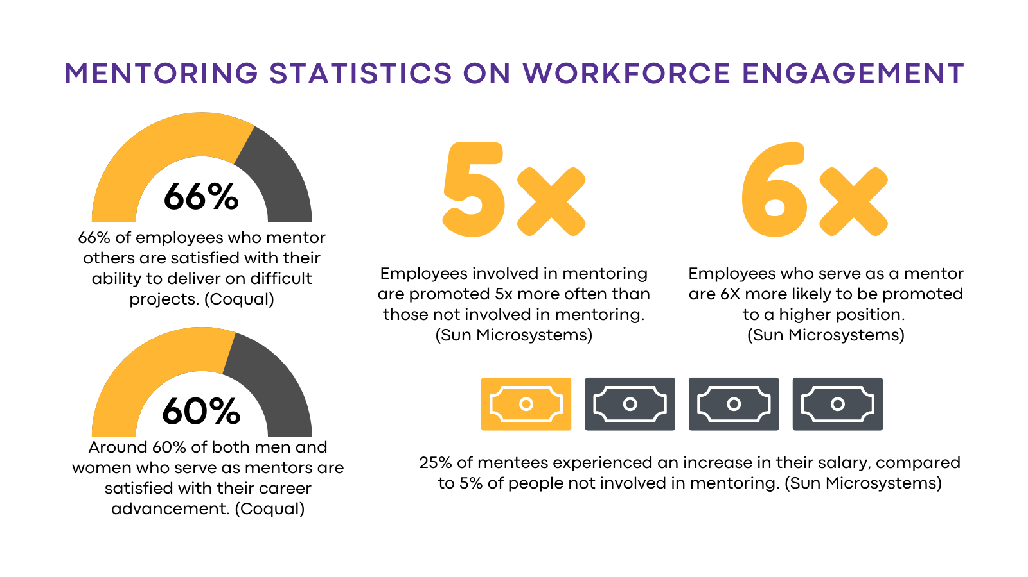
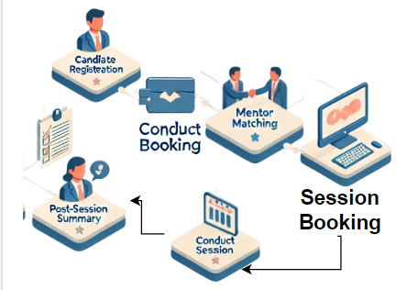
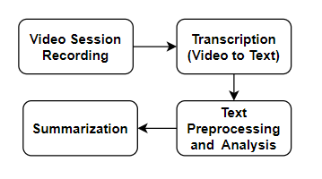
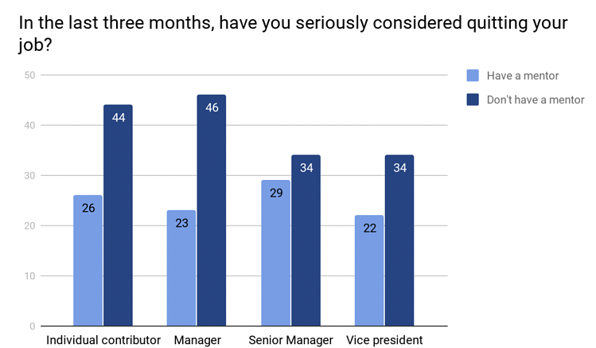
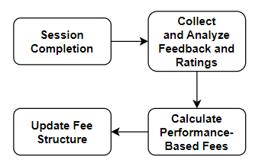
FEASIBILITY AND VIABILITY
ConnectMinds
Empowering the Future Workforce
The Need for Effective Mentoring
How Our Mentoring Platform Works
Fee = Base Fee + (Average Rating × Rating Multiplier) + (Number of Reviews × Review Multiplier)
Transforming Careers Through Mentorship

Slide 5
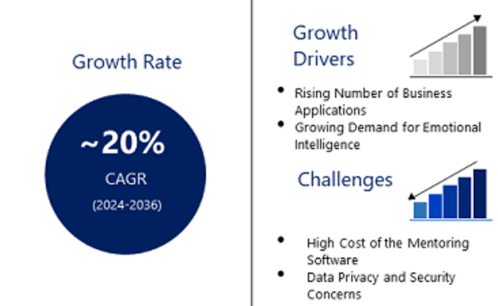
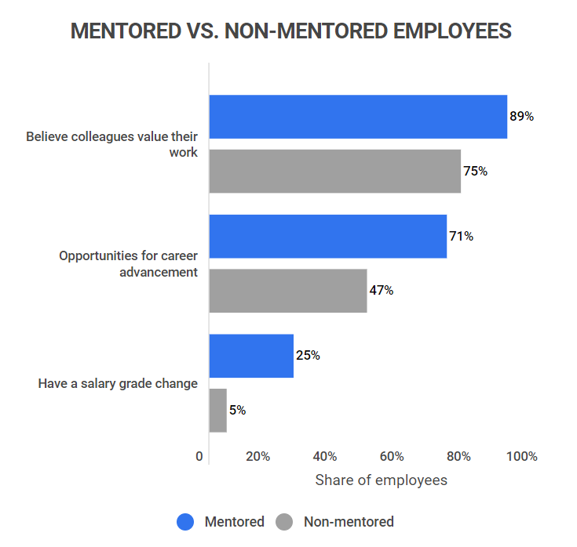

IMPACT AND BENEFITS
ConnectMinds
IMPACTS
Increased Employment Rates: Candidates who engage with mentors are more likely to secure jobs, as they receive expert guidance and referrals.
Enhanced Skill Development: Mentees benefit from personalized advice and targeted learning opportunities, leading to improved skills and competencies.
Improved Career Satisfaction: Through mentoring, individuals gain confidence and clarity in their career paths, resulting in higher job satisfaction and fulfillment.
BENEFITS
Personalized Guidance: Mentees receive tailored advice and support from experienced professionals, helping them navigate their career paths more effectively.
Networking Opportunities: The platform connects mentees with industry leaders, expanding their professional network and opening doors to new opportunities.
Seamless Interaction: With automated scheduling and embedded communication tools, the platform ensures a smooth and efficient mentoring experience.

Slide 6
RESEARCH AND REFERENCES
ConnectMinds
https://www.ncbi.nlm.nih.gov/pmc/articles/PMC8490489/
https://mentorcruise.com/
https://www.mentorcliq.com/blog/mentoring-stats
https://www.statista.com/chart/20014/unemployment-rate-india/
https://humanedge.org.uk/the-importance-of-mentoring-in-the-workplacenbsp/
https://www.researchnester.com/reports/mentoring-software-market/4289
Find a Mentor | Mentspot
https://scai.org/membership/career-development/mentor-connect
How new-age mentorship can bridge the skills gap in India | YourStory

